Slide 1
Express.js
Module 11

Slide 2
What is Express.js?

Slide 3
Express.js is a lightweight framework for Node.js that allows you to write APIs, handle HTTP requests, and implement middleware in your server-side application.

Slide 4

Express.js
Express.js exists on the back end of an application.
Express.js is considered the de facto standard for creating routes in Node.js applications.

Slide 5
What is a route?

Slide 6

Routes
Routes are a lot like traffic lanes at an airport. Certain lanes are designated for dropping people off, picking up passengers, picking up luggage, and so on.

Slide 7
Routes
Similarly, routes allow us to send and receive data depending on which route and HTTP method we use. A route can be used for different kinds of requests, to create, read, update, and delete data.
POST | Submits data to the specified resource, often causing a change on the server.
GET | Retrieves a resource from the server.
DELETE | Deletes a specified resource.
PUT | Replaces a specified resource with a payload.

Slide 8
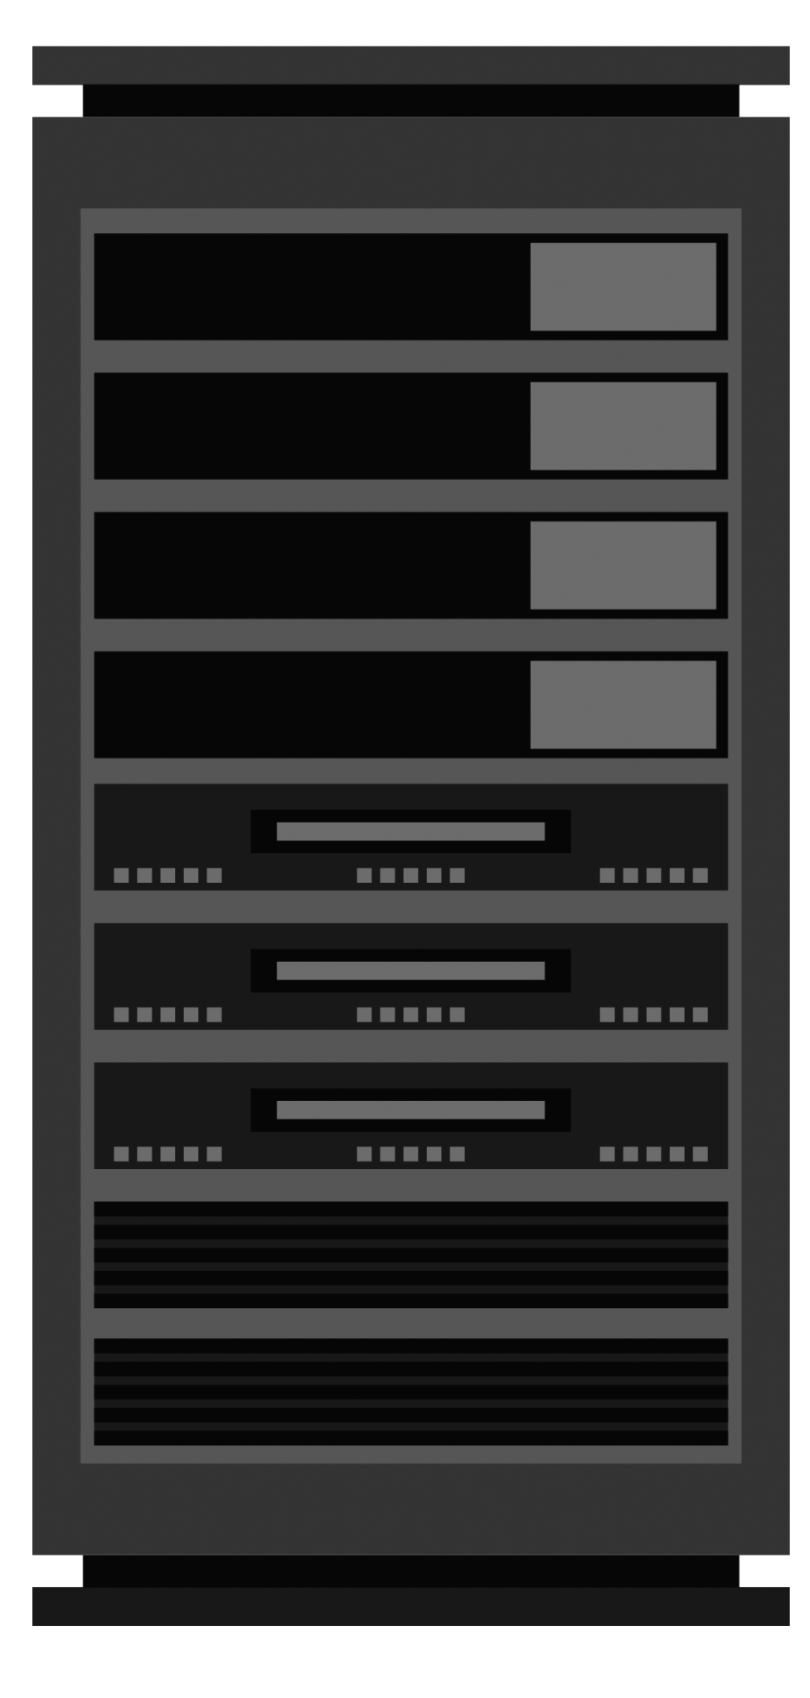


Routes
Here is an overview of how client-side requests are routed:
Routes
Get Request
http://localhost:3001/
Serves static assets like 'review html'. Listens for GET requests only.
http://localhost:3001/reviews
Delete Request
http://localhost:3001/reviews/56
Deletes a single review from the server. Listens for DELETE Requests.
http://localhost:3001/api/reviews/:id
Web Browser (Client)
POST Request
{ "Username": "keyb0redFan", "Password": "alijfauro6!%", }
Accepts JSON containing username and password. Listens for POST requests.
http://localhost:3001/api/login
Express Server

Slide 9
What is a RESTful API?

Slide 10
REST, or representational state transfer, is an architecture for creating a web service like an API.

Slide 11
What is a RESTful API?
RESTful APIs must meet the following criteria:
Comprise clients, servers, resources and requests (via HTTP).
Use stateless communications between client and server.
Serve cached objects to reduce bandwidth.
Maintain a uniform interface between the client and the server so that they can evolve separately.
Optionally, can perform code on demand.

Slide 12
What are the HTTP methods?

Slide 13
HTTP methods
You will use the following four main HTTP methods:
POST | Submits data to the specified resource, often causing a change on the server.
GET | Retrieves a resource from the server.
DELETE | Deletes a specified resource.
PUT | Replaces a specified resource with a payload.

Slide 14
What does the code look like?

Slide 15
Code Snippets
Here we have an example of a few Express.js routes:
Use get(), post(), delete(), and similar methods to create routes.
The first argument is the path, /api/reviews.
// GET route for static homepage
app.get('/', (req, res) =>
res.sendFile('index.html');
// GET route for all reviews
app.get('/api/reviews, (req, res) =>
res.json(reviewData));

Slide 16
Code Snippets (Continued)
Here we have an example of a POST route:
The path is the part of the route that comes after the base URL.
POST routes also accept the path as the first argument.
The second argument is a callback: (req, res) => { }.
// POST route to add a single review
app.post('/api/reviews', (req, res) => {
const newReview = req.body
writeToFile(destination, newReview)
res.json(`${req.method} received`);
});

Slide 17
How does this relate to the front end?

Slide 18
Client-Side Requests
We use the Fetch API to make requests to the Express.js server.
We can create fetch() requests that the server-side routes understand and respond to.
POST requests will send a request body that we capture server-side.
// Fetch request to add a new pet
const addPet = (pet) => {
fetch('/api/pets', {
method: 'POST',
headers: { 'Content-Type': 'application/json' },
body: JSON.stringify(pet),
})
.then((res) => res.json())
.then((pets) => console.log(pets));
};

Slide 19
Making fetch() requests will be no different than making calls to a third-party API. The only difference is that this API will run locally.

Slide 20
Resolving Requests
Requests must be concluded to prevent the client application from hanging indefinitely.
Methods attached to the response object allow us to conclude a request-response cycle.
app.put('/api/pets/:pet_id', (req, res) => {
// Logic to update a pet
res.json('Pet updated');
});

Slide 21
Mini-Project

